Slide 1

Progress Seminar On WEBSITE ON HOGWARTS COLLEGE OF WITCHCHART AND WIZARDRY
Presented By
Pushpak Ashwin Fasate
Guided By
Mrs. Roshani Talmale
Department of Computer Science & Engineering
S. B. JAIN INSTITUTE OF TECHNOLOGY MANAGEMENT AND RESEARCH,NAGPUR
An Autonomous Institute, Affiliated to RTMNU, Nagpur

Slide 2
Contents
Objectives
Introduction
Literature survey
Website Design
Technology to be Used
Modules
Screenshots
Advantages & Applications
References
S. B. Jain Institute of Technology Management and Research
2

Slide 3
Problem statement &Objectives
Problem statement
Now a days there is a lot of fan of harry potter movies but in movies there is no specific expiation on HOGWARTS COLLEGE so through my page the page fan will able to access the proper information about the Hogwarts collage.
Objectives
To Reduce efforts of user.
To Provide full satisfaction to user.
To Provide easy access to the user.
S. B. Jain Institute of Technology Management and Research
3

Slide 4
Introduction
For this project, I created a website named as Hogwarts Collage Of Witchchart And Wizardry in which I used HTML, CSS programming language. For my project I wanted to work on web development so I created this webpage by taking idea from a fictional Hogwarts University from movie Harry Potter. Users will be able to use the website to know about Hogwarts Collage Of Witchchart And Wizardry. In this website I created different sections / pages for detailed information about Hogwarts where users can visit easily directly through menu bar.
S. B. Jain Institute of Technology Management and Research
4

Slide 5
Literature Survey
Websites / Paper / Article | Reviews / Finding
https://harrypotter.fandom.com/wiki/Hogwarts_School_of_Witchcraft_and_Wizardry | Content are good. Use of animation are impressive
https://www.wizardingworld.com/features/origins-of-hogwarts-school-of-witchcraft-and-wizardry | 1. Simple but attractive 2. Styling as done accurately
http://hogwartsuk.weebly.com/ | 1. Content are good but background is not matching with the website.

Slide 6
Hogwarts collage Of Witchchart and Wizardry
Hogwarts
Course
Gallery
Login
Website Design: Flowchart
Welcome To Hogwarts College
Hogwarts Clubs
Sorting Hat
The wand chooses The Wizard
Discover Your Wand.
Discover Your Patrous
Triwizard
Tournament
Quidditch
HOGWART'S COURSES
HOGWART'S CLUBS
GRYFFINDER
RAVENCLAW
SLYTHERIN
HUFFLEPUFF
Login platform
Sin up platform
HOGWARTS BREAKFAST
HOGWARTS CHRISTMAS
QUIDDITCH HOUSE CUP
THE TRIWIZARD TOURNAMENT
PROFESSOR SERVERUS SNAPE
PROFESSOR MINERVA MCGONAGALL
HOGWART'S EXPRESS
S. B. Jain Institute of Technology Management and Research
6

Slide 7

Use case Diagram
start
View navbar
Select item
login
Register
View menu
Select page
View page
close

Slide 8
Technology to be Use
Front End:
HTML, CSS
IDE:
vs code
Hardware used:
Laptop , Computer and android phone
S. B. Jain Institute of Technology Management and Research
8

Slide 9
Modules
Module Names
1. Home
2.Course
3.Gallery
4.log In
S. B. Jain Institute of Technology Management and Research
9

Slide 10
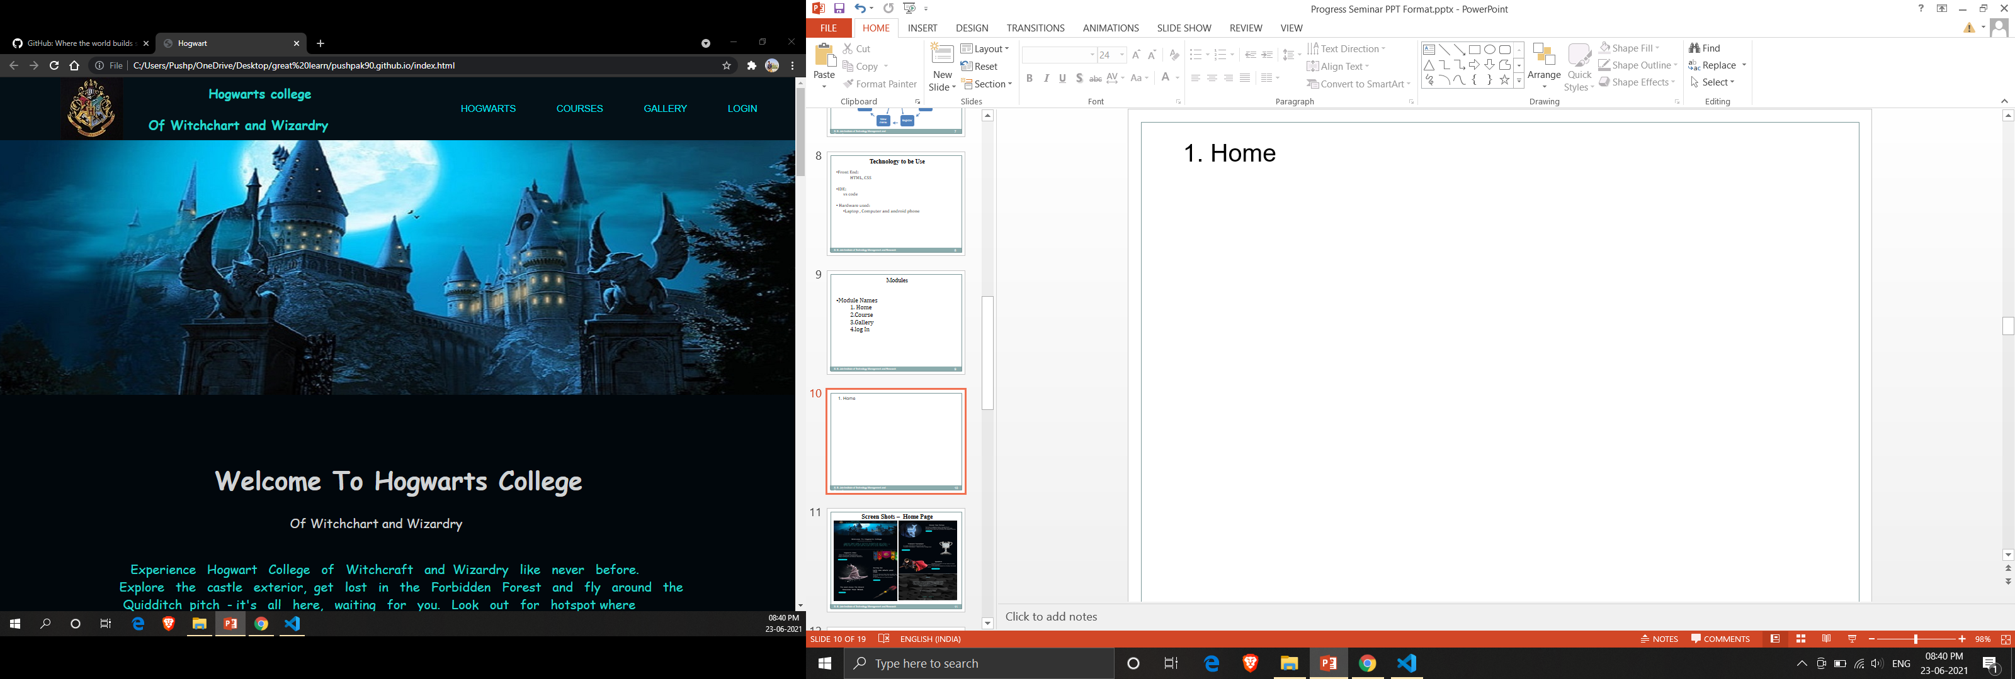
1. Home
In this home page, there are some information about Hogwarts collage and there is a
nav bar to navigate the different pages of the website.

Slide 11
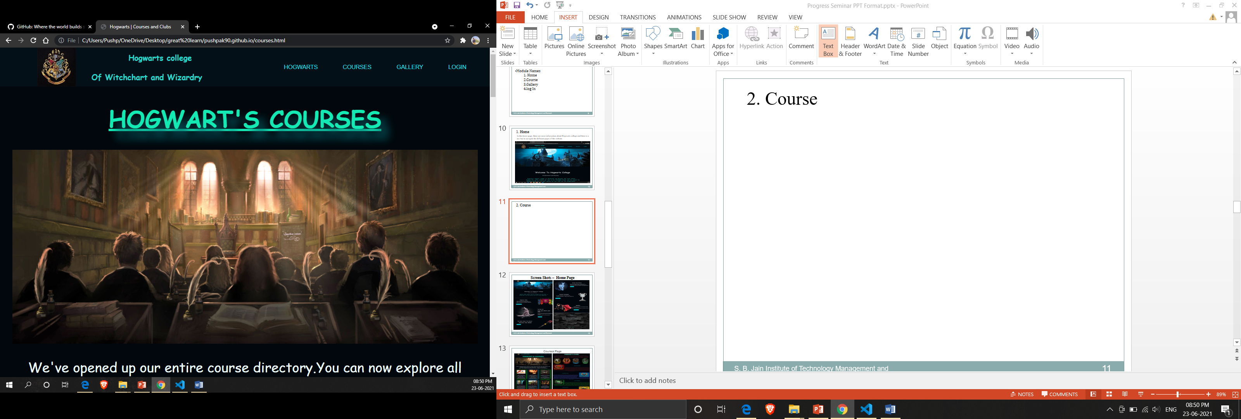
2. Course
When we click course it open new page it content courses and Hogwarts clubs.

Slide 12
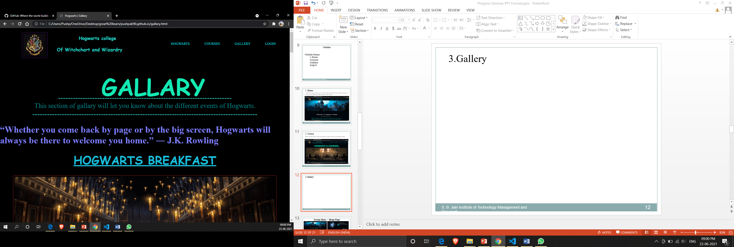
3.Gallery
When we click on gallery it open a new page know as gallery there are photos of their
collage and introduction of their professor.

Slide 13
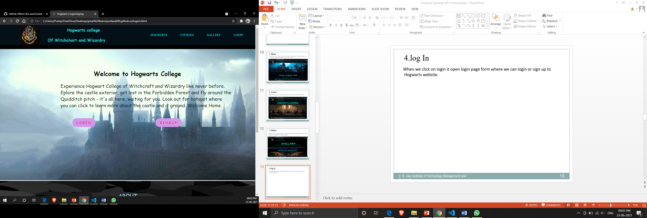
4.log In
When we click on login it open login page form where we can login or sign up to
Hogwarts website.

Slide 14
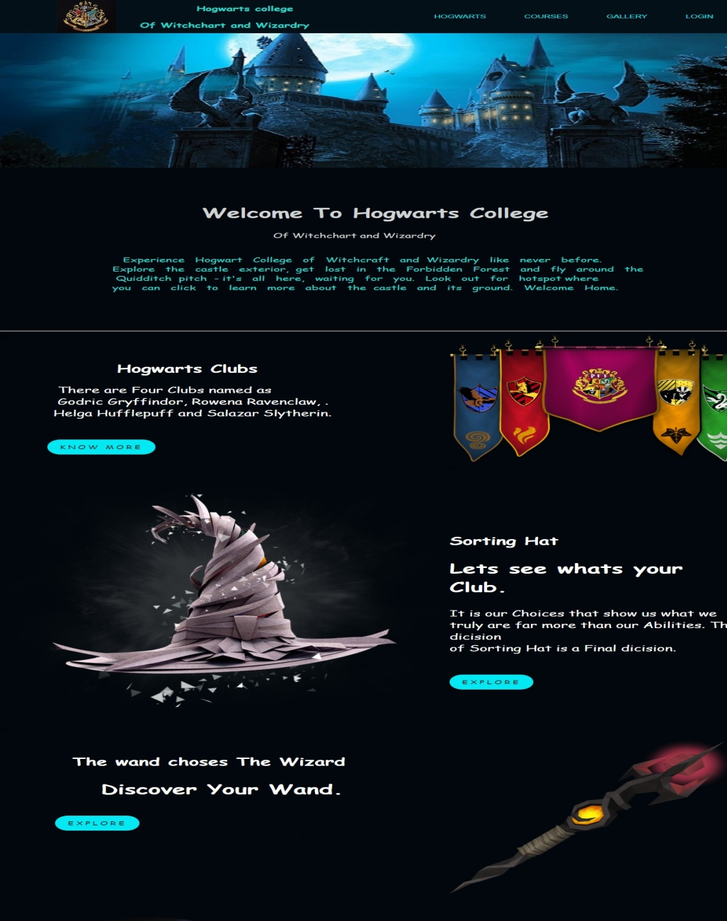


Screen Shots – Home Page
S. B. Jain Institute of Technology Management and Research
14

Slide 15
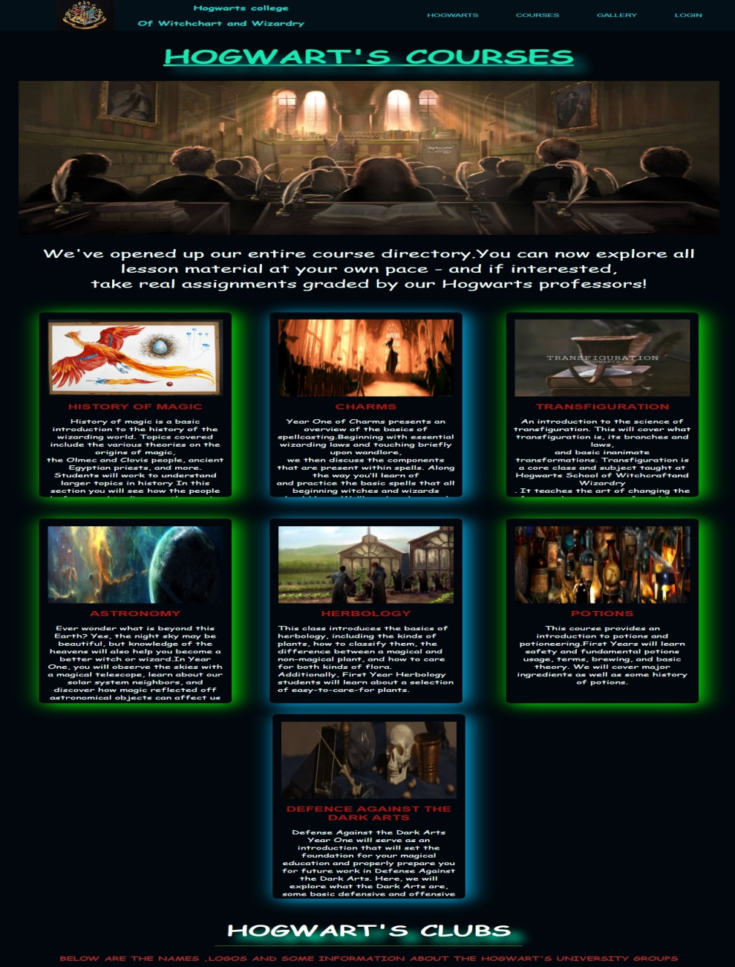

Courses Page

Slide 16
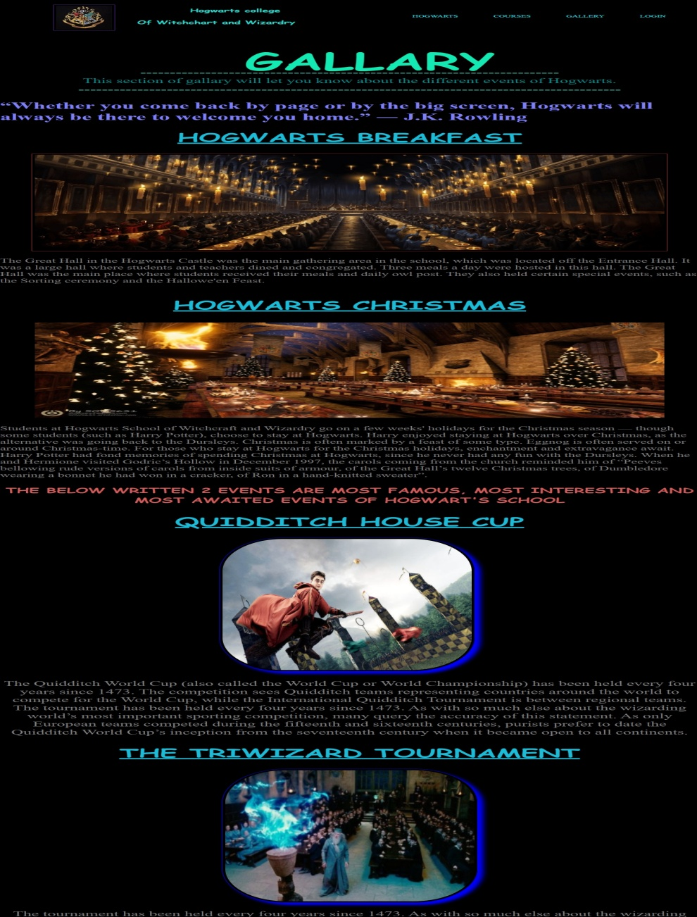
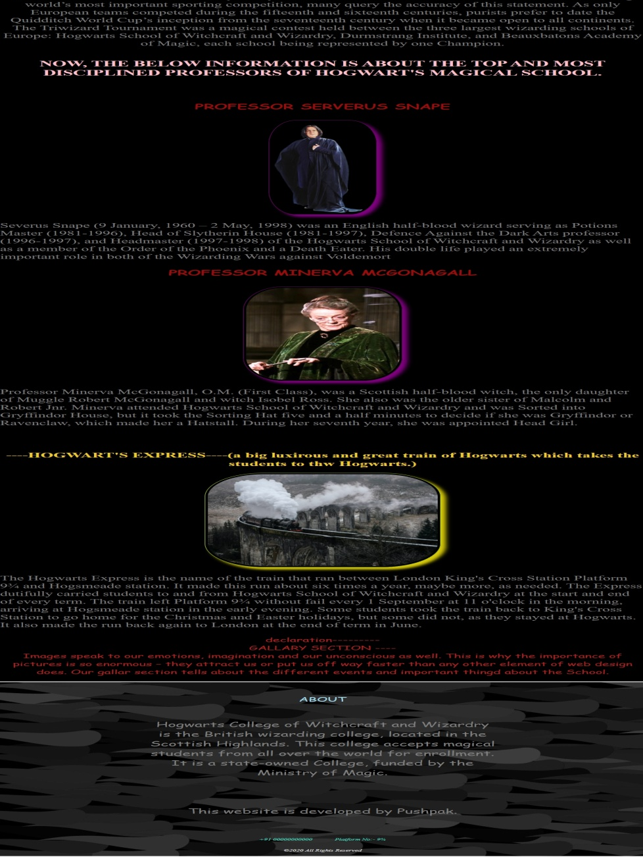
Gallery Page

Slide 17
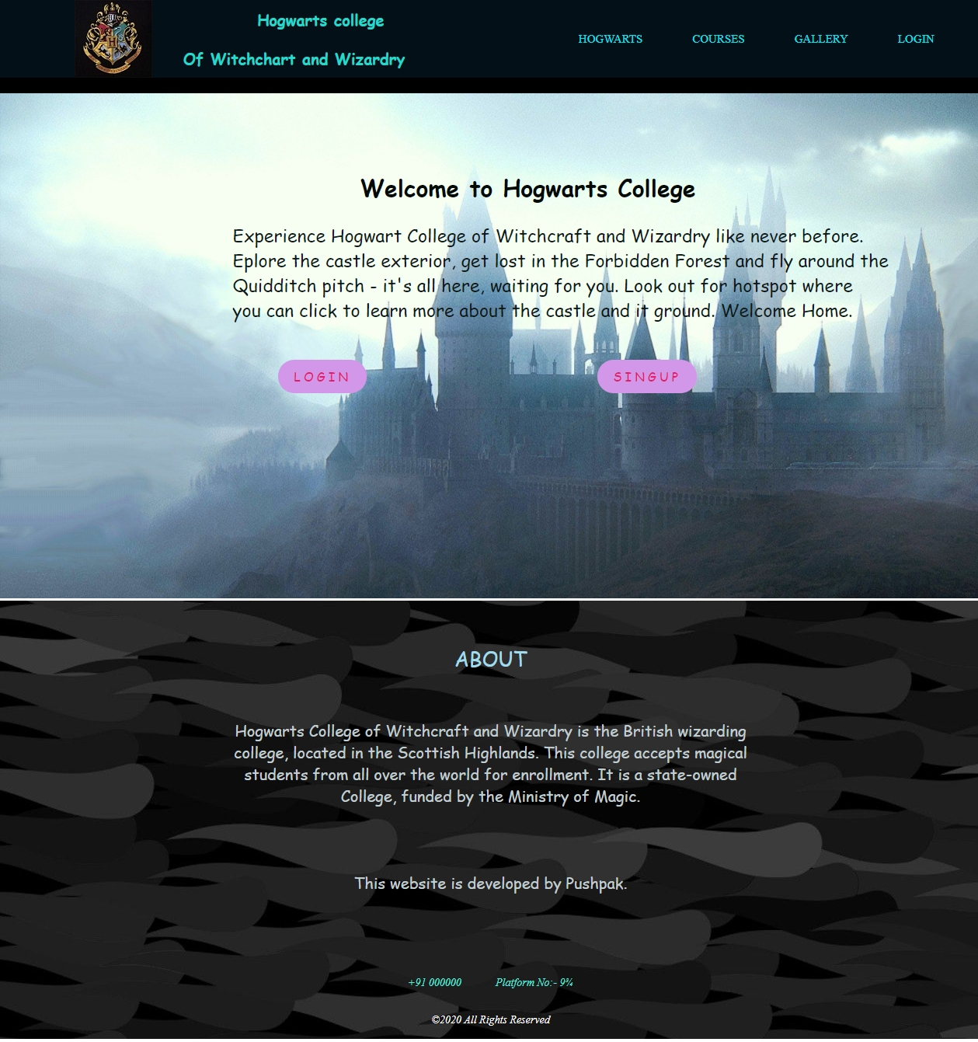
Login And Sign Page

Slide 18
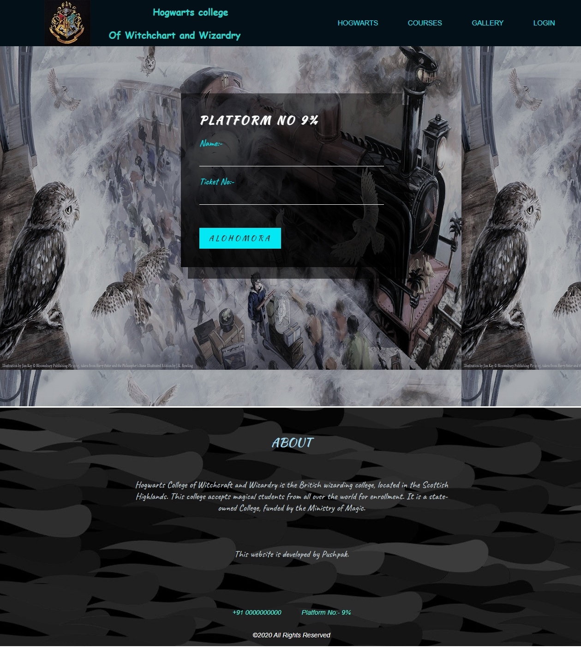
Login Page

Slide 19
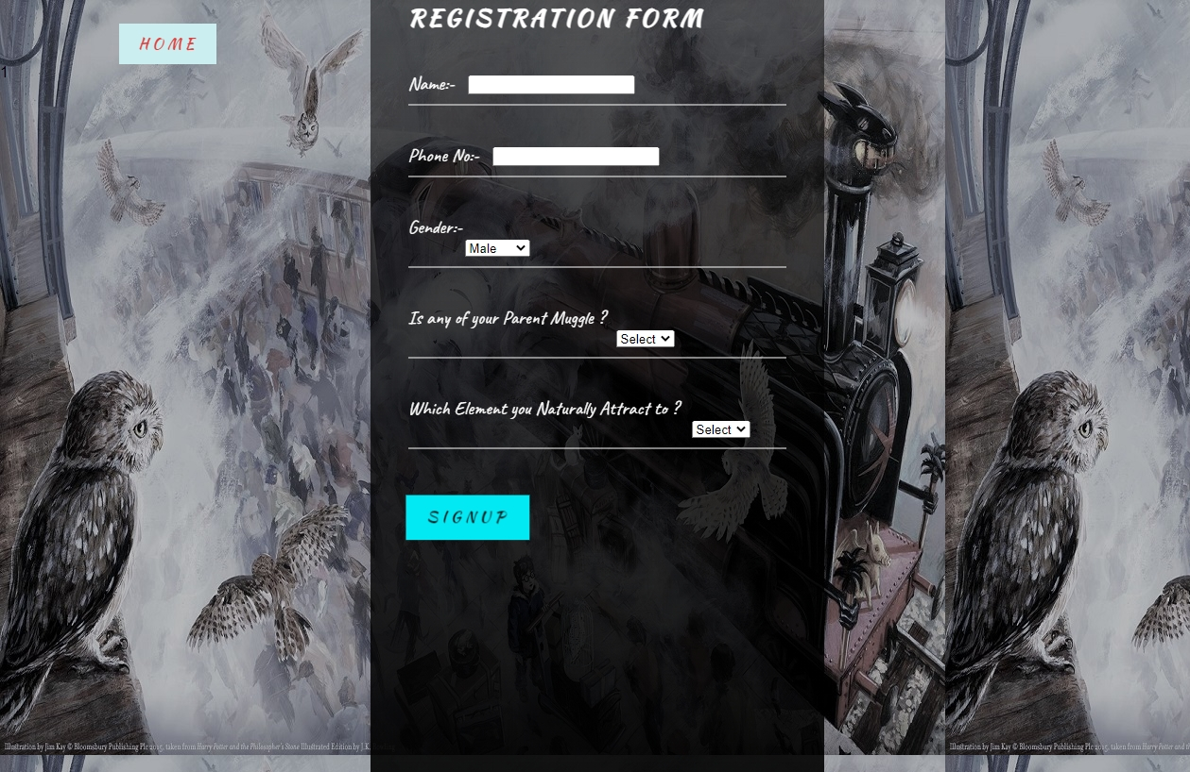
Sign Up Page

Slide 20
Advantages
Less time spent talking to users over the phone.
Eliminate printed materials.
Allow users to get update about new things.
Applications
S. B. Jain Institute of Technology Management and Research
20

Slide 21
References
Websites:
www.w3schools.com
www.sololearn.com
www.greatlearning.in
www.geeksforgeeks.org
S. B. Jain Institute of Technology Management and Research
21

Slide 22
Thank You
S. B. Jain Institute of Technology Management and Research
22

